Slide 1




MALLA REDDY
TECHNICAL CAMPUS
A Constituent Unit of
MALLA REDDY VISHWAVIDYAPEETH
(Deemed to be University)
Maisammaguda, Medchal (Dist), Hyderabad, Telangana
PRESENTRED BY:
TEAM 20 -
MAZELAB
KVS AKSHITH --25MVCSMR0232(L)
D GOPICHAND --25MVCSMR0210
M SANJAY --25MVCSMR0246
T PRANAV TEJA --25MVCSMR0269
EDUCATION INNOVATION EXCELLENCE SERVICE TO SOCIETY

Slide 2
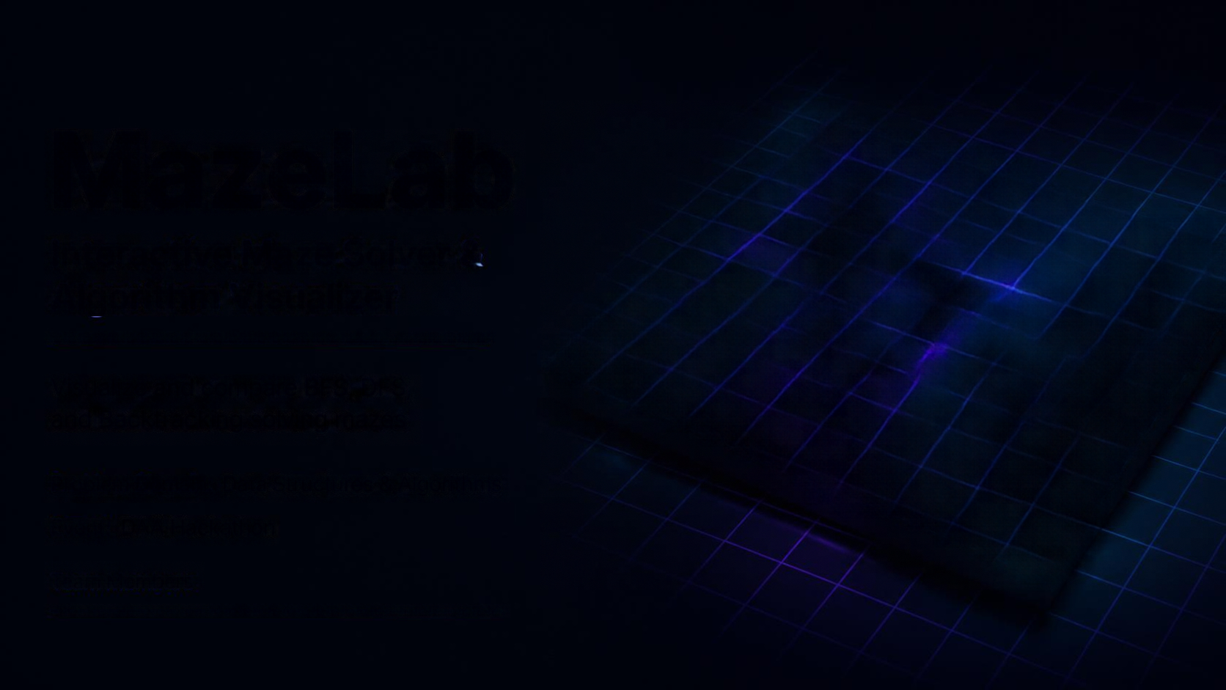
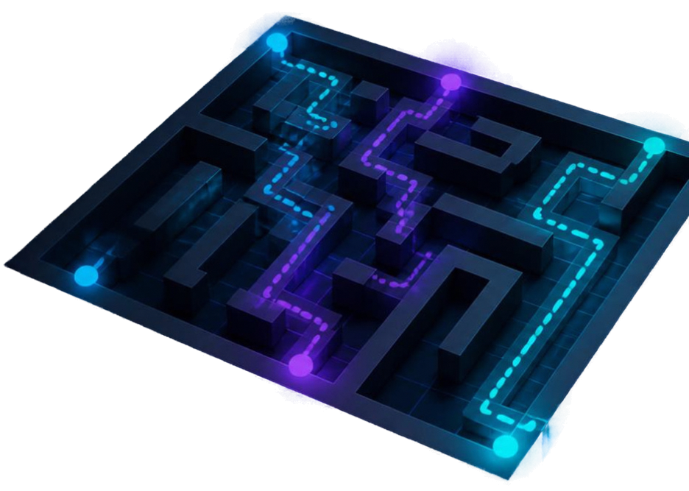
.
MazeLab
Interactive Maze Solver & Algorithm Visualizer
Visualize and compare BFS, DFS,
and Backtracking solving mazes
Problem Domain: Data Structures & Algorithms
Event: DAA Hackathon
Team Members

Slide 3
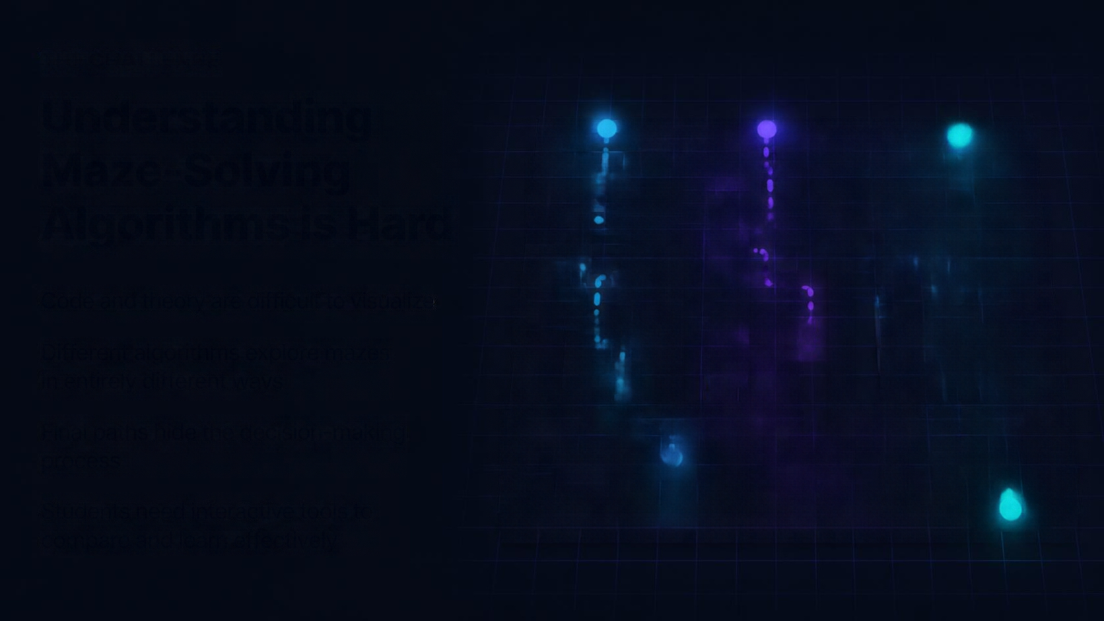
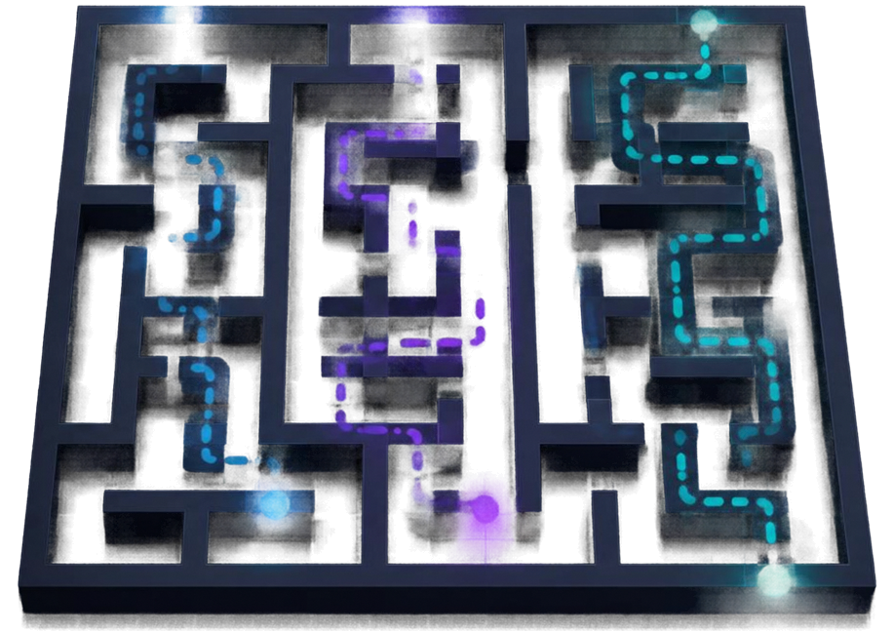
THE CHALLENGE
Understanding Maze-Solving Algorithms is Hard
Code and theory are difficult to visualize
Different algorithms explore mazes
in entirely different ways
Final paths hide the decision-making process
Students need interactive tools to
compare and learn effectively

Slide 4
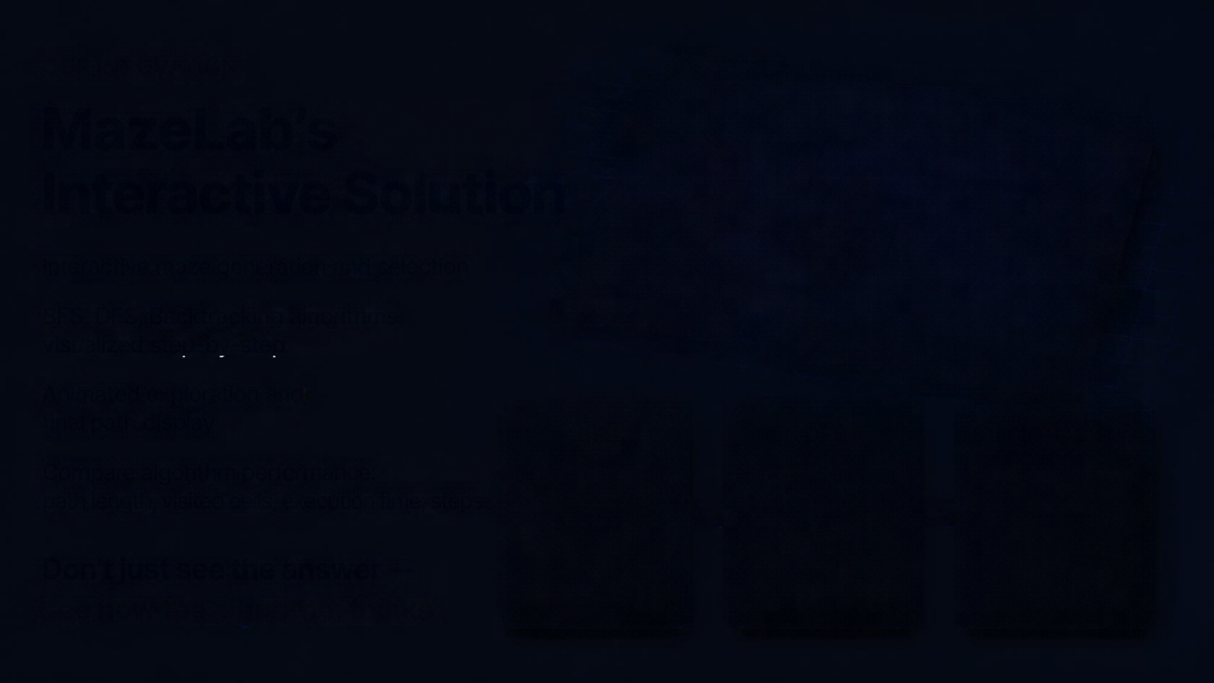
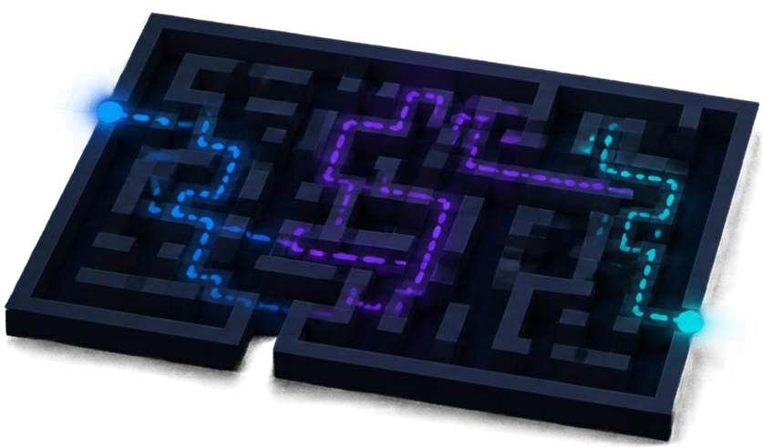
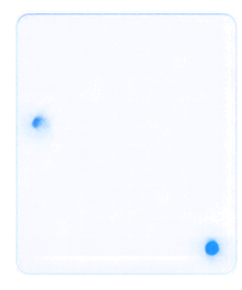
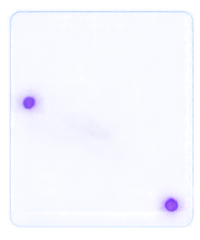
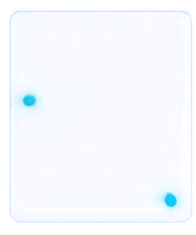
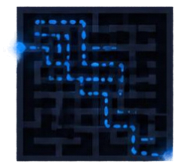
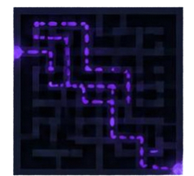
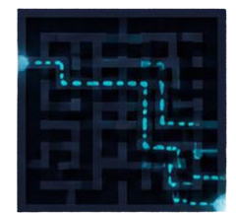


OUR INNOVATION
MazeLab’s Interactive Solution
Interactive maze generation and selection
BFS, DFS, Backtracking algorithms
visualized step-by-step
Animated exploration and
final path display
BFS
DFS
BACKTRACKING
Compare algorithm performance:
path length, visited cells, execution time, steps
Don’t just see the answer —
see how the algorithm thinks.

Slide 5

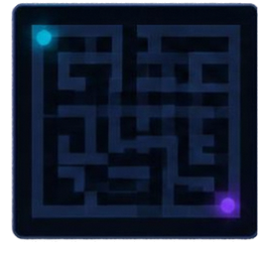
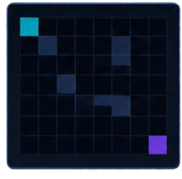

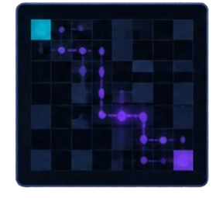
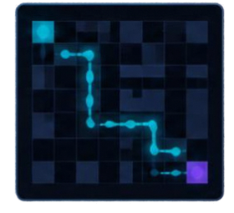








How It Works
01
02
03
04
05
CREATE MAZE
GRID MODEL
CHOOSE ALGORITHM
ANIMATE SOLUTION
SEE RESULTS
BFS
DFS
BACKTRACKING
Design or select
a maze
Converted into
a 2D grid
Pick the algorithm
to solve
Visualize exploration and path discovery
Review path and performance metrics
NODES VISITED
PATH LENGTH
TIME TAKEN
MEMORY USED
Total cells explored
Steps in the solution
Execution time
Resource consumption

Slide 6
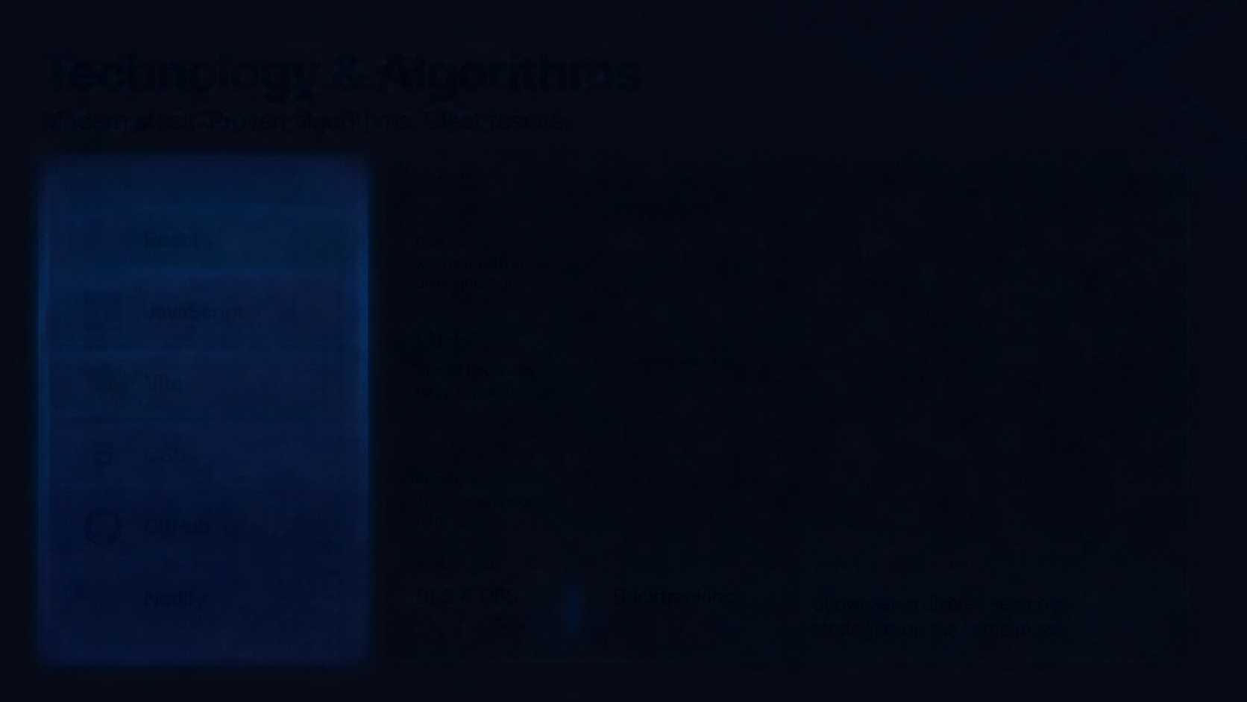


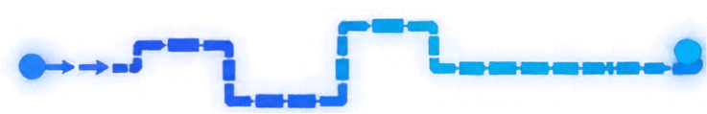





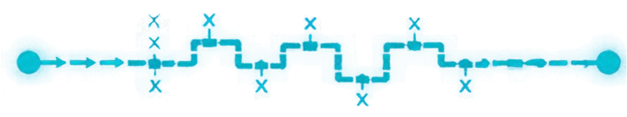




Technology & Algorithms
Modern stack. Proven algorithms. Clear results.
TECH STACK
ALGORITHMS
BFS
React
Queue
Shortest path in unweighted grid
JavaScript
DFS
Vite
Stack / Recursion
Deep exploration
CSS
Backtracking
Recursion
Try, check, undo, retry
GitHub
COMPLEXITY
WHY WE CHOSE THESE
Netify
BFS & DFS
O(V + E)
Backtracking
O(4^V)
Showcasing diverse search strategies on the same maze

Slide 7
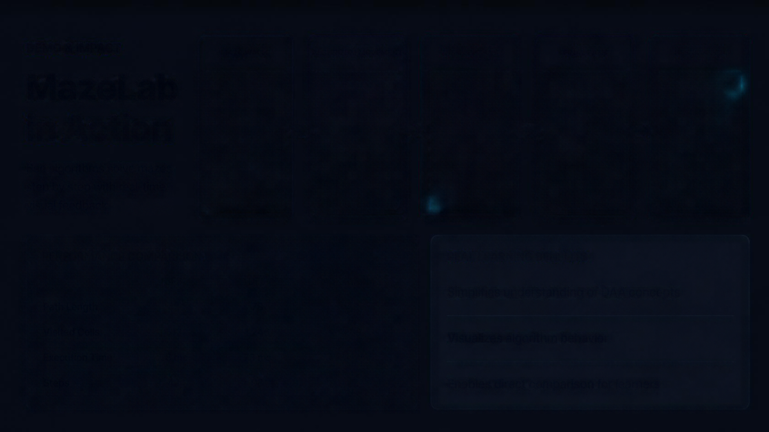





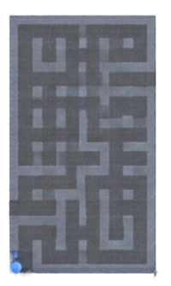
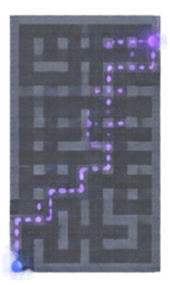
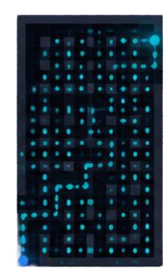
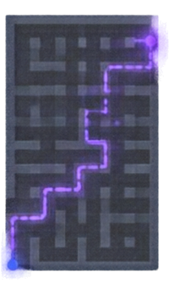
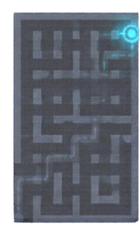





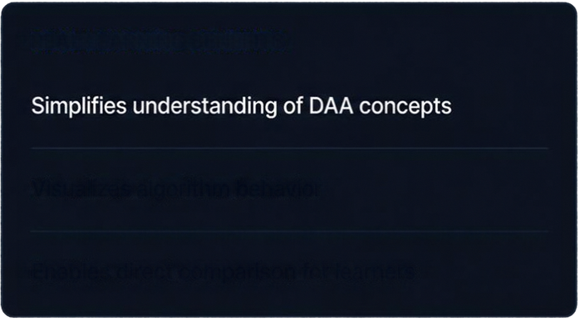
DEMO & IMPACT
MAZE WALLS
ALGORITHM MOVEMENT
VISITED CELLS
FINAL PATH
DESTINATION
MazeLab
in Action
See algorithms solve mazes step by step with real-time visual feedback.
PERFORMANCE COMPARISON
REAL LEARNING BENEFITS
BFS
DFS
BACKTRACKING
Path Length
42
78
42
Visited Cells
512
1,246
489
Visualizes algorithm behavior
Execution Time
28 ms
73 ms
31 ms
Steps
42
98
42
Enables direct comparison for learners

Slide 8

The Future of MazeLab
WHAT’S NEXT
New algorithms: Dijkstra and A*
Custom maze editor
Advanced analytics and larger mazes
Multiplayer algorithm challenges
Educational difficulty levels
Scalable classroom deployment
MazeLab
Visualize. Explore. Understand Algorithms.
Thank you
Q&A

